Slide 1
Teenage Love
Colette Ickes

Slide 2
Can Teenagers be in Love?
For me, there is the assumption that every teenager, in America, believes that their parents don’t think that teenagers can be in love.
I am in a relationship and I believe that my boyfriend and I are in love.
My parents have shown and told me that I can’t be in love because I’m “too young” or I “don’t know what it’s like to be in love.”
After hearing this I wondered why my parents think this. Do other adults feel the opposite?

Slide 3
Choosing the Question What I Wanted to Learn
Hearing from my parents that they think I can’t be in love at this age upset me. I felt that I truly loved my boyfriend and listening to what my parents had to say was disturbing. After thinking through what they said, I had to know why they thought this. I also wanted to know if any other adults thought opposite so that I wouldn’t feel so crazy about my feelings towards this boy.
From researching, I wanted to know if there were any countries where the majority of people agreed with teenage love and/or disagreed with teenage love. I wanted to learn why adults think like they do towards teenage relationships.

Slide 4
Knowledge Before the Research
I already know that my Dad and step-mom are against me being in a relationship with my boyfriend. The main reason is his age but also because they do not want me to be in a relationship in the first place. They feel that I am too young and don’t understand how hard relationships can be.
I also knew that my Mom was supportive of the relationship. Mostly because she did not want me sneaking around and lying about the relationship. However, she has had her experiences when she was a teenager and has different views than my Dad and step-mom.

Slide 5
Research
For my research, I looked online for any countries in the world that favored teenage love and relationships. I found that America is against these relationships more than many European countries.
Online, I also found graphs of the differences of teenage pregnancies, abortions and birth rates, etc. between America and other European countries.
Another form of research I did was interviewing my family, parents and siblings, about their views on teenage relationships and teenage love.

Slide 6
What I Learned
From interviewing my family, I learned that my parents and siblings think that teenagers are, “too young…. Their brains aren’t fully formed yet…. They have less experience…. They can’t understand the concept of love.” However from asking if they had opposing views, I learned that, “kids are humans too. They can fall in love just like anybody else…. Feelings as a teenager were still love. Different, but still love…. Love is the same at any age.” While teenagers are still young and don’t have as much experience as adults, they can still feel the same type of love just like anybody else.
I also learned that in the Netherlands, most parents allow their children and their significant others spend the night at each other’s houses as long as they are responsible with the relationship, using contraceptives and sometimes being supervised.

Slide 7
What I Learned Continued…
The U.S. Government has funded programs to avoid teen pregnancy and abortion. However, American pregnancy rates are three times higher than Germany and France, and more than four times higher than in the Netherlands.
The use of contraceptives, such as condoms or birth control pills, is much higher in Europe than in America. On average, females in Europe were 4 times more likely to use contraceptives than females in America.
The HIV diagnosing percentage in America is six times higher than Germany and three times greater than the Netherlands. The United State’s protection from teenage pregnancy is much lower than that of Europe.
In all relationships, even teenage relationships, there are balances. One is called the lust-balance: the difference of wanting sexual gratification and wanting intimacy, also known as sex and love.

Slide 8
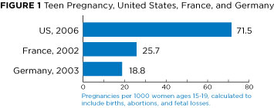
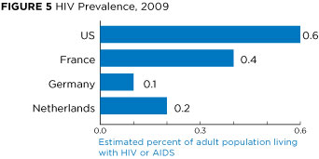
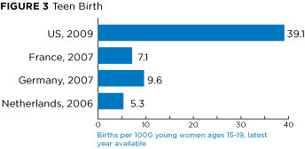
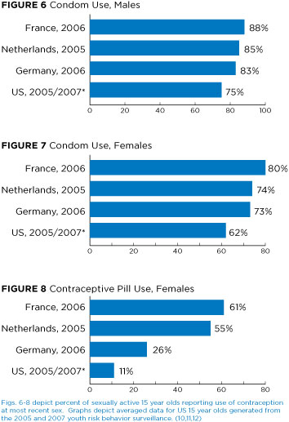
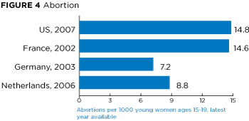

Slide 9
Conclusion
Throughout the process, everything came together as teenagers can be in love as long as they are responsible with their relationship. Using protection, maturity and responsibility can create a successful teenage relationship that could potentially result in love. There are those parents out there who do not and will not believe that teenagers can be in love.
After all the research and interviews, I’ve found that I still love my boyfriend as much as I did before this assignment. But, this love is something different. Maybe not as mature or sophisticated as our parents may feel but it’s still love.

